Slide 1
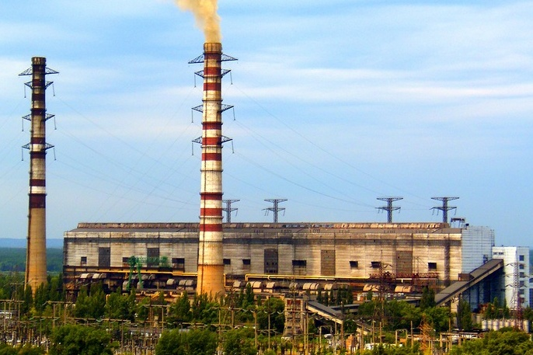
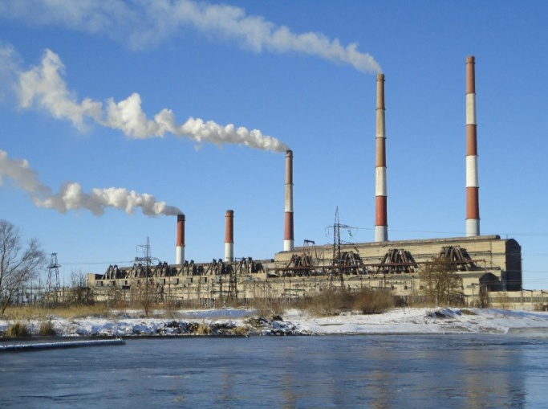
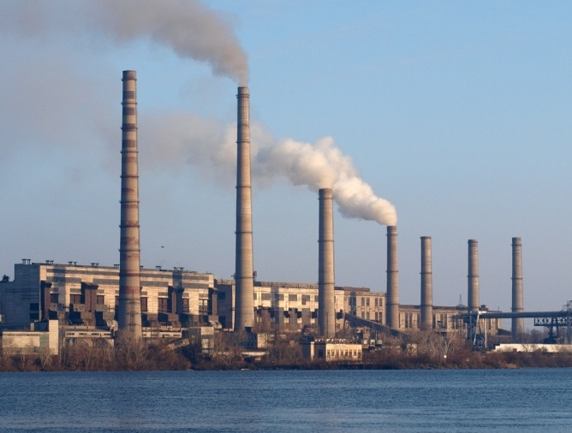
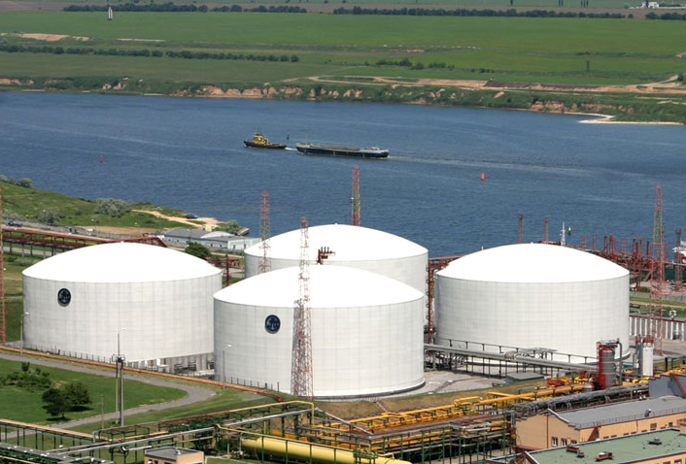
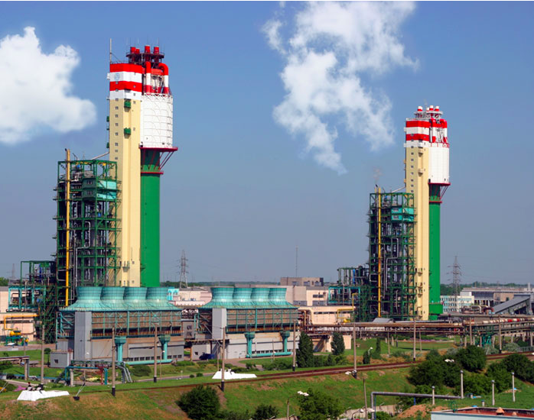
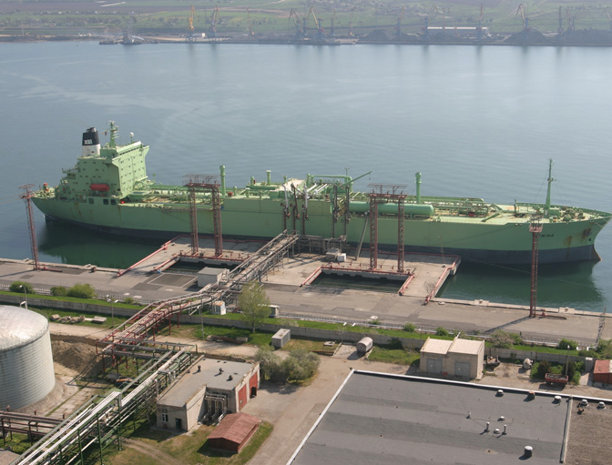
APPENDIXES
TOP-12 SOES FOR PRIVATIZATION IN 2016
13

Slide 2
TOP SOES FOR PRIVATIZATION IN 2016
Company | Industry | Revenue 2015 year, USD mln* | Share for privatization, %
Odesa Portside Plant | Fertilisers | 512,5 | 99,6%
Tsentrenergo | Energy Generation | 314 | 78,3%
Kharkivoblenergo | Energy Distribution | 226 | 65,0%
Mykolayivoblenergo | Energy Distribution | 98,5 | 70,0%
Zaporizhzhyaoblenergo | Energy Distribution | 378 | 60,2%
Khmelnytskeoblenergo | Energy Distribution | 65 | 70,0%
Ternopiloblenergo | Energy Distribution | 46,5 | 51,0%
Cherkasyoblenergo | Energy Distribution | 11 | 46,0%
Odesa CHP | Energy Generation | 18 | 100,0%
Kherson CHP | Energy Generation | 12,5 | 99,8%
Mykolayiv CHP | Energy Generation | 11 | 100,0%
Dniprodzerzhynsk CHP | Energy Generation | 12 | 99,9%
*Average NBU exchange rate 21,8447 UAH/USD for 2015
14

Slide 3
FERTILIZERS: ODESA PORTSIDE PLANT
Key highlights
OPP fertilizers output, kt
The Odesa Portside Plant (OPP) is a major chemical production company accounting for 17% of ammonium nitrate and 19% of urea production capacity in Ukraine
A specific advantage of the plant is that it is located at the end-point of the ammonia pipeline Tolyatti-Gorlovka-Odesa and operates sea chemicals transshipment terminal:
Transhipment services provide additional source of revenue
Apart from ammonium nitrate and urea OPP produces liquid nitrogen, carbon dioxide, liquid oxygen and sodium sulphate
The plant due to its strategic location and connection to the chemical transportation infrastructure is export oriented
Export sales account up to 85% of the output
Major export destinations incl. EU countries and USA
The OPP’s financial performance is highly dependent on natural gas prices, with gas constituting 80 % of the production costs
In 2014, apart from the natural gas supplies from the state-owned company Naftogaz OPP started importing gas from Hungary through reverse facilities
The Odesa Portside Plant is state-owned by 99.57%
Ammonia pipeline and chemical producers
Rivneazot
Cherkasskiy Azot
Severdonets’kiy Azot
Dniproazot
to Toliattiazot
Stirol (Gorlovka)
Odesa Portside Plant
Key financials (according to national GAAP)
OPP capacities overview, mt pa
UAH m | 2012 | 2013 | 2014 | 2015
Revenue | 5,372 | 4,904 | 5,428 | 11,195
Gross profit | 168 | (811) | (39) | 1426
EBITDA | (12) | (1,034) | (132) | 983
Net profit | (116) | (1,144) | (270) | 211
Total assets | 2,240 | 2,756 | 8,827 | 3,352
Financial debt | - | - | 4,603 | 3,178
Production
Ammonia | 1.1
Urea | 0.9
Liquid nitrogen, carbon, dioxide, liquid oxygen and sodium sulphate (non-significant quantities)
Total production capacities | 2.0
Transshipment
Ammonia | 4.3
Urea | 5.0
Methanol | 1.0
Liquid fertilizers | 0.5
Total transshipment capacities | 10.8
Source: Company’s data
1
15

Slide 4
ENERGY GENERATION: TSENTRENERGO
Key highlights
Share in electricity generation in Ukraine
PJSC Tsentrenergo is Ukraine’s 2nd largest thermal generator with capacity of 7,600 MW. It operates 3 power plants in Kyiv, Kharkiv and Donetsk regions and has own repair services company Remenergo
The Company produces up to 9% of total electricity in Ukraine, generating 15-18 TWh annually. PJSC Tsentrenergo’s share among all thermal GenCos reaches 22-23%
In March 2013, a fire broke out at PJSC Tsentrenergo’s Vuhlehirska thermal power plant which forced shutdown of Vuhlehirska TPP for 7 months of 2013. Currently, 3 out of 4 damaged coal-fired blocks are fully reconstructed and operational
Further decrease in electricity generation in 2014 is explained by the scarcity of the anthracite coal consumed by Trypilska and Zmievska TPPs and which was previously produced by the mines located in Donetsk and Lugansk regions currently left on the separatists-controlled territory. The company tried to make up for the shortage by importing coal from South Africa and Russia
Majority stake in PJSC Tsentrenergo is state-owned (78.3%),
Key assets geographical location
Key financials (according to national GAAP)
P&L (UAH m) | 2011 | 2012 | 2013 | 2014 | 2015
Revenue | 7,180 | 9,063 | 7,454 | 7,558 | 6,864
Gross profit | 546 | 884 | 780 | 294 | 312
Gross margin | 8% | 10% | 10% | 4% | 5%
EBITDA | 391 | 558 | 770 | 311 | 249
EBITDA margin | 5% | 6% | 10% | 4%
Net profit | 35 | 234 | 487 | 71 | 70
Key indicators
 | Trypilska | Zmiivska | Vuhlehirska | Total
Installed capacity | 1 800 MW | 2 200 MW | 3 600 MW | 7 600 MW
incl. gas-fired blocks | 2x300 MW | - | 3x800 MW | 3 000 MW
incl. coal-fired blocks | 4x300 MW | 6x175 MW 3x275 MW 1x325 MW | 4x300 MW | 4 600 MW
Coal grade | A/T | A/T | G | -
Fuel consumption per kW | 406 g/kW | 405 g/kW | 370 g/kW | -
Electricity production (2014) | 3,869 GWh | 5,002 GWh | 3,643 GWh | 12,514 GWh
Headcount, employees* | 1 812 | 2 879 | 2 852 | 8 226**
Balance Sheet (UAH m) | 2011 | 2012 | 2013 | 2014 | 2015
Total assets | 4,318 | 4,507 | 5,027 | 5,281 | 6,644
incl. PPE | 2,147 | 2,091 | 2,026 | 2,088
Total equity | 1,863 | 2,086 | 2,503 | 2,428 | 2,481
Total liabilities | 2,454 | 2,420 | 2,523 | 2,853 | 4,162
incl. financial debt | 567 | 699 | 784 | 182
Source: Company’s data
16
*In 2013. ** incl. Remenergo
1
Notes:
4

Slide 5
ENERGY DISTRIBUTION: KHARKIVOBLENERGO
Key highlights
Key assets geographical location
JSC Kharkivoblenergo is one of the largest power distributing companies in Ukraine, which transmits and supplies energy to the highly industrialized Kharkiv region
The Company serves 1.2 m households and 3,000 industrial customers (mostly machine-building plants). The Company’s largest consumers are water and heating utilities, the Kharkiv metro operator, and power machinery plants Turboatom and Elektrovazhmash
The 2 groups - households and industrial customers account for 42.5% and 30.7% of the oblenergo’s energy sales, followed by commercial non-industrial consumers (23.5%), and municipal users (3.3%)
JSC Kharkivoblenergo owns a 47,273 km grid with 8,162 MVA of transformer capacity
Number of employees at the Company is ca 7,100
The State holds a 65.0% stake in JSC Kharkivoblenergo
Kyiv
Kharkiv region
Region area: 31.4k sq. km
Region population: 2.8 m
Key industries: machinery, construction materials, chemical industry, food and processing industry, agriculture
Key financials
Key indicators
UAH m | 2012 | 2013 | 2014 | 2015
Revenue | 3,397 | 3,656 | 3,948 | 4,941
Gross profit | 190 | 128 | 67 | 226
EBITDA | 448 | 294 | 298 | 312
Net profit | 29 | 29 | 30 | 32
Total assets | 2,271 | 2,376 | 2,667 | 3,344
Total equity | 1,955 | 2,007 | 2,247 | 2,635
Total liabilities | 316 | 369 | 420 | 709
Operating metrics | 2012 | 2013 | 2014
Distributed to customers (GW·h) | 5,577 | 5,670 | 7,364
Grid losses (%) | 13.8% | 13.04% | 12.44%
Source: Company’s data
1
17

Slide 6
ENERGY DISTRIBUTION: MYKOLAYIVOBLENERGO
Key highlights
Geographic location and region of operations
PJSC Mykolayivoblenergo transmits and supplies electricity in Mykolayiv region; the Company is the monopolist in the region. It serves 476,000 residential customers and 16,000 commercial and industrial customers: population and industrial enterprises are the main customers groups accounting for 46% and 24% of sales respectively
Its installed transformer capacity is 3,361 MVA (6,000 substations). PJSC Mykolayivoblenergo owns 25,000 km of overhead transmission lines and 1,463 km of underground power cables. The Company also owns three small HPPs: 12,2 GW·h of electricity produced in 2014
The state regulator approved UAH 80m of CapEx for the Company for 2014 and UAH 74m for 2015: modernization and reconstruction of transmission lines and equipment account for the bulk of CapEx. The wear rate of the lines averages 60%
The Company has around 3,550 employees
In terms of financial leverage, PJSC Mykolayivoblenergo has relatively low bank debt, but owes UAH 376m to the state wholesale electricity market operator Energorynok. These liabilities were accumulated before 2010 and are now structured as a long-term debt
The State holds a 70% stake in the Company.
Kyiv
Mykolayiv region
Region area: 24.6k sq. km
Region population: 1.2 m
Key industries: shipbuilding and other machinery manufacturing, food processing
Key financials
Key indicators
UAH m | 2012 | 2013 | 2014 | 2015
Revenue | 1,326 | 1,379 | 1,505 | 2,149
Gross profit | 159 | 105 | 114 | 120
EBITDA | 138 | 49 | 111 | 118
Net profit | 32 | 17 | 15 | 11
Total assets | 968 | 998 | 1 034 | 1 077
Total equity | 335 | 345 | 357 | 365
Total liabilities | 633 | 653 | 677 | 713
Operating metrics | 2012 | 2013 | 2014
Distributed to customers (GW·h) | 2,647 | 2,615 | 2,577
Grid losses (%) | 13.7% | 12.3% | 12.2%
Source: Company’s data
1
18

Slide 7
ENERGY DISTRIBUTION: ZAPORIZHOBLENERGO
Key highlights
Geographic location and region of operations
PJSC Zaporizhyaoblenergo is a top-10 electricity distributor in Ukraine, supplying electricity to the heavily industrialized Zaporizhya region
The Company serves 783k residential customers and 23k commercial and large industrial enterprises including:
steelmakers Zaporizhstal and Dniprospetsstal, Zaporizhya Ferroalloy
engineering plants (e.g. Motor Sich)
The oblenergo owns a 40,000 km low-voltage transmission grid with 9,749 MVA of installed capacity
Number of employees at the Company is ca 5,800
The State holds a 60.25% stake in the Company
Kyiv
Zaporizhya region
Region area: 27.2k sq. km
Region population: 1.9 m
Key industries: engineering, metallurgy, energy-generation, industrial goods production and agriculture
Key indicators
Key financials
Operating metrics | 2012 | 2013 | 2014
Distributed to customers (GW·h) | 8,327 | 8,298 | 8,472
Grid losses (%) | 8.12% | 8.97% | 8.31%
UAH m | 2012 | 2013 | 2014 | 2015
Revenue | 5 050 | 4 747 | 4 070 | 8 260
Gross profit | 64 | 77 | 8 | 169
EBITDA | 133 | 180 | 8 | 148
Net profit | 23 | 25 | 6 | 21
Total assets | 2 290 | 1 487 | 1 736 | 2 367
Total equity | 45 | 45 | 45 | 393
Total liabilities | 1 107 | 1 144 | 1 365 | 1 974
Source: Company’s data
19

Slide 8
ENERGY DISTRIBUTION: KHMELNYTSKEOBLENERGO
Key highlights
Key assets geographical location
PJSC Khmelnytskeoblenergo transmits and supplies electricity in Khmelnitsky region; accounts for 75% of electricity sales in the region
The Company serves 550,000 residential customers and 19,500 commercial and industrial customers. Population, industrial and other commercial enterprises are the main customers groups accounting for 42%, 14% and 11% of sales respectively
Its installed transformer capacity is 3,127 MVA (7,300 substations)
PJSC Khmelnytskeoblenergo owns 35,000 km of overhead transmission lines and 1,000 km of cable power transmission lines
The Company has around 3,560 employees
The state regulator approved UAH 58m of CapEx for the Company for 2014 and UAH 51m for 2015
The State holds a 70% stake in the Company.
Kyiv
Khmelnitsk region
Region area: 20.6k sq. km
Region population: 1.3 m
Key industries: machinery manufacturing, sugar production and other food processing
Key financials
Key indicators
UAH m | 2012 | 2013 | 2014 | 2015
Revenue | 933 | 1,001 | 1,101 | 1,420
Gross profit | 90 | 110 | 60 | 119
EBITDA | 115 | 129 | 109 | 155
Net profit | 31 | 49 | 26 | 39
Total assets | 544 | 899 | 878 | 1 551
Total equity | 418 | 709 | 724 | 1 239
Total liabilities | 126 | 191 | 154 | 312
Operating metrics | 2012 | 2013 | 2014
Distributed to customers (GW·h) | 2,067 | 2,127 | 2,121
Source: Company’s data
20

Slide 9
ENERGY DISTRIBUTION: TERNOPILOBLENERGO
Key highlights
Geographic location and region of operations
PJSC Ternopiloblenergo transmits and supplies electricity to consumers in Ternopil region. It owns a 23,870 km grid with total transformer capacity of 4,382 MVA
The Company serves ca 0.5 m of residential customers and several hundreds of industrial customers (mostly light and food industry plants and agri-businesses)
Consumers base:
53.6% - residential customers
13.6% - industrial customers
12.9% - municipal and state users
c.20% - other non-industrial customers
The Company’s headcount is c. 2,300 employees
The State holds a 51% stake in JSC Ternopiloblenergo.
Kyiv
Ternopil region
Region area: 13.8k sq. km
Region population: 1.1 m
Key industries: agriculture, light and food industry, machine-building and tourism
Key financials
Key indicators
UAH m | 2012 | 2013 | 2014 | 2015
Revenue | 655 | 721 | 787 | 1,015
Gross profit | 585 | 68 | 34 | 82
EBITDA | 64 | 81 | 36 | 87
Net profit | 6 | 13 | (16) | 17
Total assets | 653 | 708 | 752 | 766
Total equity | 538 | 587 | 562 | 577
Total liabilities | 115 | 121 | 190 | 189
Operating metrics | 2012 | 2013 | 2014
Distributed to customers (GW·h) | 1,215 | 1,234 | 1,235
Grid losses (%) | 18.0% | 17.79% | 17.26%
Source: Company’s data
21

Slide 10
ENERGY DISTRIBUTION: CHERKASYOBLENERGO
Key highlights
Electric power supply dynamics
PJSC Cherkasyoblenergo operates as an electric energy distributor and transmits electric energy in Cherkasy region. Company purchases electric energy from the state-owned enterprise “Energorynok” and distributes it to consumers via direct sales regulated by individual contracts.
Electricity distribution in Ukraine is currently managed by 26 oblenergos, one per each region (except for Kyiv and Donetsk with two oblenergos). Being a natural monopolies, oblenergos are regulated by National Electric Energy Regulatory Committee (NERC).
NERC sets retail tariffs for oblenergos based on expected costs, grid losses and CAPEX needs (cost-plus basis).
Licensed area for Cherkasyoblenergo operations comprises 20.9k km. The enterprise supplies power to more then 632k consumers.
Total length of aboveground electric power lines with voltage range of 0.4-154 kW amounts to 29.4 thousand km, whereas underground power cables with 0.4 – 110 kW voltage have length of 1.9 thousand km.
Seasonality is common for the industry. In autumn and winter electric power supply increases by 25-30%. Maintenance cost related to transmission lines also tend to grow due to adverse weather conditions during that time.
Government holds 46% stake in PJSC Cherkasyoblenergo.
Enterprise location
Kyiv
PJSC Cherkasyoblenergo
Key financials
Sales structure by type of consumers
UAH m | 2012 | 2013 | 2014 | 2015
Sales | 1,360 | 1,326 | 1,466 | 2,350
Gross profit | 31 | 79 | 68 | 131
EBITDA | 52 | 56 | 70 | 74
Net income | 4 | 4 | 4 | 25
Total assets | 498 | 514 | 601 | 833
Debt | 6 | 9 | 10 | 550
Source: Company’s data
1
22

Slide 11
ENERGY GENERATION: ODESA CHP
Key highlights
Key assets geographical location
PJSC Odesa TPP is the monopolist thermal power producer in the city of Odesa, one of the largest cities in Ukraine with population of c. 1m
The fuel mainly used is natural gas and to some extend heavy oil
The thermal power is transmitted via heated water for heating and hot water supply. Heated water and steam are supplied via 4 main thermal pipelines to the network of the municipal company Odesa Heating Supply responsible for delivering the power to the final customers (households and offices)
Electricity generated is sold to the state-company Energorynok
Similar to other TPPs in Ukraine operations of PJSC Odesa TPP are seasonal. The heating power and electricity are produced during the heating season- usually from October to April
The stake owned by the state in PJSC Odesa TPP is 99.989%
Kyiv
PJSC Odesa TPP
Revenue Split, 2015
Key financials
Key indicators
P&L (UAH m) | 2012 | 2013 | 2014 | 2015
Revenue | 273.4 | 275.0 | 266.4 | 386
Gross profit | 0.4 | 3.5 | (4.7) | 2
EBITDA | (0.2) | (81.6) | (107.0) | (55)
Net profit | (15.7) | (51.2) | (70.3) | (60)
Operational parameters
Installed capacity
Heating | 779 Gcal/hour
Electricity | 68 MWt
Production volumes, 2014
Heating | 397,866 Gcal
Electricity | 58.9m kWh
Other parameters
# of employees (2014) | 420
Balance Sheet (UAH m) | 31-Dec-12 | 31-Dec-13 | 31-Dec-14 | 31-Dec-15
Total assets | 178.7 | 289.4 | 331.8 | 382
incl. PPE | 56.2 | 92.2 | 87.5
Total equity | (107.6) | (158.8) | (229.1) | (329)
Total liabilities | 286.3 | 448.3 | 560.9 | 710
incl. financial debt | - | - | -
incl. trade accounts payable | 213.5 | 362.8 | 475.9
Source: Company’s data
1
23

Slide 12
ENERGY GENERATION: KHERSON CHP
Key highlights
Key assets geographical location
PJSC Kherson TPP is a combined heat and power producer which is servicing up to 50% of the households which are receiving centralized heating supply of the Kherson city, the center city of the Kherson region having almost 400k inhabitants
Natural gas in the main fuel while heavy oil could be used as supplementary. Natural gas is supplied by the state company NJSC Naftogaz
Similar to other TPPs in Ukraine, operations of Kherson TPP are seasonal. The heating power and electricity are produced during the heating season usually from October to April
The stake owned by the state in PJSC Kherson TPP is 99.8%
Kyiv
PJSC Kherson TPP
Revenue split, 2015
Key financials
P&L (UAH m) | 2012 | 2013 | 2014 | 2015
Revenue | 193.1 | 192.5 | 189.5 | 273
Gross profit | 0.3 | (5.8) | (14.6) | (14)
EBITDA | 22.4 | (17.7) | 32.7 | (36)
Net profit | 8.5 | (27.8) | 15.6 | (51)
Key indicators
Operational parameters
Installed capacity
Heating | 735 Gcal/hour
Electricity | 80 MWt
Production volumes, 2014
Heating | 203,442 Gcal
Electricity | 72.9m kWh
Other parameters
# of employees (2014) | 540
Balance Sheet (UAH m) | 31-Dec-12 | 31-Dec-13 | 31-Dec-14 | 31-Dec-15
Total assets | 189.5 | 199.1 | 222.7 | 295
incl. PPE | 84.7 | 86.1 | 78.8
Total equity | 9.2 | (21.2) | (5.9) | (62)
Total liabilities | 180.2 | 220.3 | 228.5 | 356
incl. financial debt | - | - | -
incl. trade accounts payable | 105.2 | 157.1 | 153.8
Source: Company’s data
24
Notes:
12

Slide 13
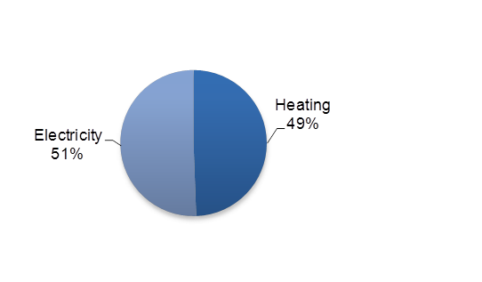
ENERGY GENERATION: MYKOLAYIV CHP
Key highlights
Key assets geographical location
PJSC Mykolayiv TPP supplies heating power to more than 40% of the households and enterprises of the city of Mykolayiv, the center city of the Mykolayiv region having almost 500k inhabitants
The company is also important electricity generator in Mykolayiv
Natural gas in the main fuel while heavy oil could be used as supplementary
Similar to other TPPs in Ukraine operations of Mykolayiv TPP are seasonal. The heating power and electricity are produced during the heating season - usually from October to April
PJSC Mykolayiv TPP is 100% state-owned
Kyiv
PJSC Mykolayiv TPP
Revenue split, 2015
Key financials
Key indicators
P&L (UAH m) | 2012 | 2013 | 2014 | 2015
Revenue | 188.5 | 199.0 | 177.7 | 245
Gross profit | 5.7 | 15.3 | 4.6 | (4)
EBITDA | 22.7 | 0.1 | 26 | 5
Net profit | 15.2 | (2.7) | 17.2 | 0.3
Operational parameters
Installed capacity
Heating | 410 Gcal/hour
Electricity | 40 MWt
Production volumes, 2014
Heating | 343,528 Gcal
Electricity | 94m kWh
Other parameters
# of employees (2014) | 567
Balance Sheet (UAH m) | 31-Dec-12 | 31-Dec-13 | 31-Dec-14
Total assets | 75.9 | 103.5 | 117.9 | 132
incl. PPE | 25.1 | 33.1 | 34.6
Total equity | 33.1 | 25.7 | 42.9 | 38
Total liabilities | 42.8 | 77.8 | 74.7 | 94
incl. financial debt | - | - | -
incl. trade accounts payable | 29.4 | 63.1 | 57.9
Source: Company’s data
25

Slide 14
ENERGY GENERATION: DNIPRODZERZHYNSK CHP
Key highlights
Key assets geographical location
PJSC Dniprodzerzhynsk TPP is a combined heat and power producer which is servicing residential area of Dniprodzerzhynsk located on the right bank of the Dnipro river. Dniprodzerzhynsk is an industrial city in Dnipropetrovsk oblast having app. 240k inhabitants
Natural gas is the main fuel used by the TPP. It is supplied by the state company NJSC Naftogaz
The stake owned by the state in PJSC Dniprodzerzhynsk TPP is 99.9277%
Kyiv
PJSC Dniprodzerzhynsk TPP
Revenue split, 2015
Key financials
Key indicators
P&L (UAH m) | 2012 | 2013 | 2014 | 2015
Revenue | 187.7 | 183 | 176 | 269
Gross profit | 9.4 | 6 | 5 | 21
Gross margin | 5.0% | 3.0% | 3.1%
EBITDA | (32.0) | 1.5 | 14.2 | (43)
EBITDA margin | -17.1% | 0.8% | 8.1%
Net profit | (2.2) | 0.1 | 0.5 | (48)
Operational parameters
Installed capacity
Heating | 313 Gcal/hour
Electricity | 61.6 MWt
Production volumes, 2014
Heating | 323,437 Gcal
Electricity | 61.5m kWh
Other parameters
# of employees (2014) | 409
Balance Sheet (UAH m) | 31-Dec-12 | 31-Dec-13 | 31-Dec-14 | 31-Dec-15
Total assets | 261.7 | 350.5 | 498.6 | 642
incl. PPE | 32.0 | 42.5 | 44.9
Total equity | 2.2 | (23.7) | (23.3) | (61)
Total liabilities | 259.4 | 374.2 | 521.9 | 703
incl. trade accounts payable | 152.3 | 281.6 | 395.1
Source: Company’s data
26

